Slide 1
Business Challenge
Cohort Analysis
Anirudh Unni, Raissa Franco & Ayse Kocyigit

Slide 2
Project Overview
Goal: Understand the long-term behavior of IronHack Payments users by grouping them into cohorts based on their acquisition month.
Key Objectives:
Track how user engagement changes over time
Identify which user groups are the most valuable
Measure key performance metrics like usage frequency, payment incident rates, and revenue per cohort

Slide 3
EDA & QA
Taking a critical look at the given data
Created a unified user ID and removed irrelevant columns
Cleaned missing values (e.g., user_id, send_at)
Converted timestamps to datetime and set monthly periods
Combined two datasets: cash requests + fees
Notes:
First of all we started doing our EDA and QA and for that we look at each data frame separately
We thought about our metrics and our cohorts and decided we want to generate our own cohort using the user ID and send_at.
We made decisions about which columns were relevant for us so we can keep them and decided to do so
For the next step we only look through this superset with the columns and and start checking the quality of the data, the missing values and so on.
We saw that user ID and deleted account complement each other and combined them because of missing values.

Slide 4
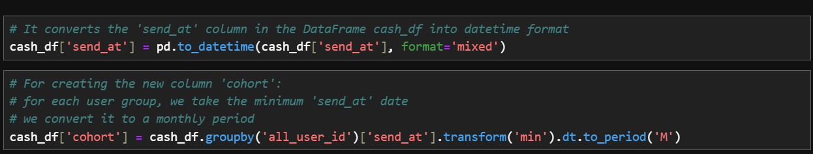
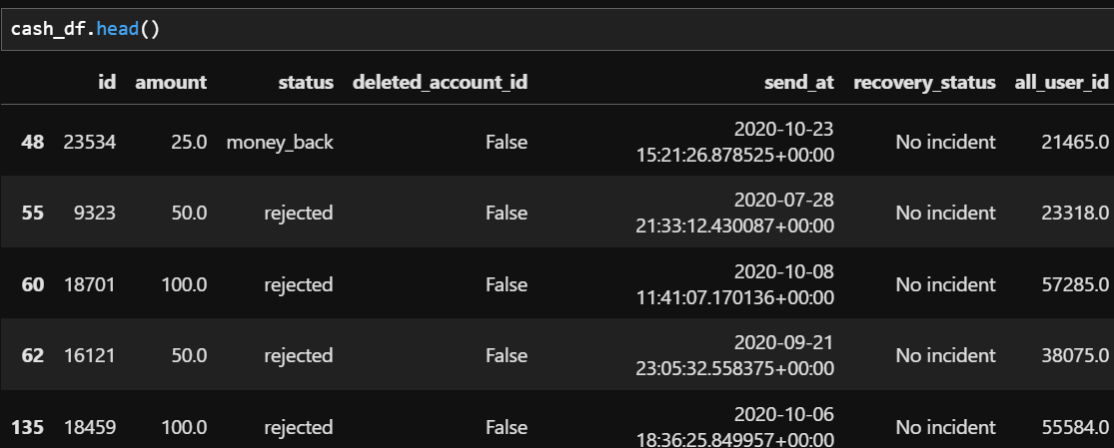
Dataframe cash_request

Slide 5
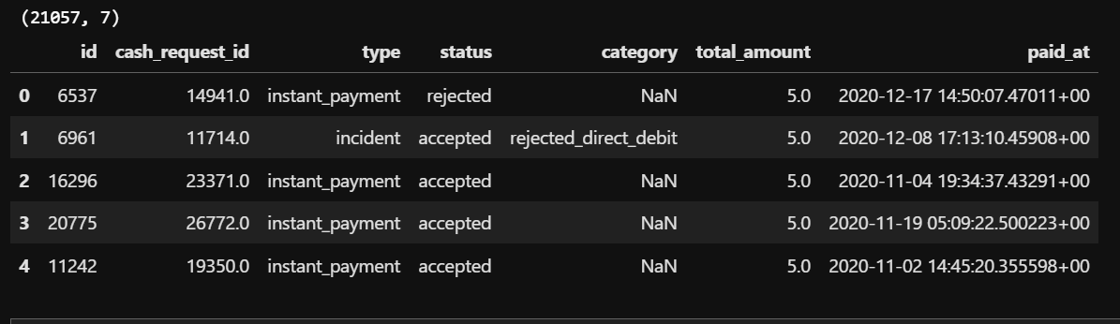
Dataframe data_fees

Slide 6
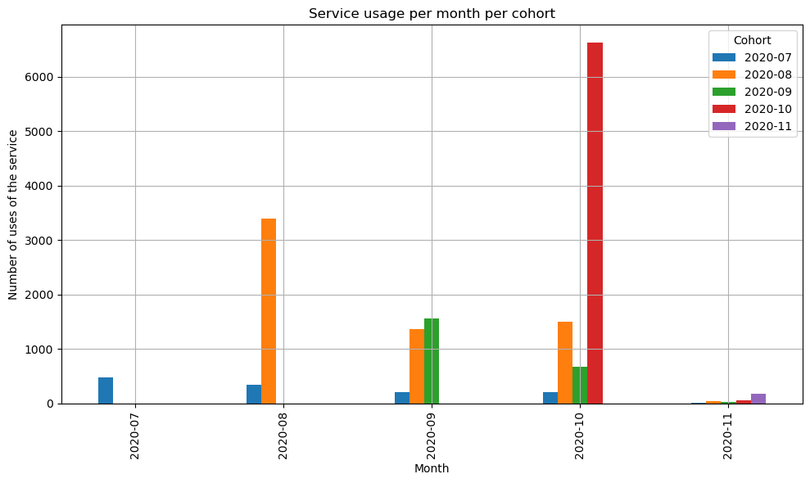
1st metric: Frequency of service usage
Insights:
A drop in the number of users within each cohort over time
Most users start using the cohort in October
Significant drop in users in November
Notes:
This chart tracks how frequently users in each cohort used the service over time
Each line or bar represents a cohort, starting from the month they joined.
The usage drops within each cohort over time, most users started in october and then we can see a radical drop in usage in November.
Like you can see the cohort in blue, slowly dropping the usage over time.
This might be caused by the holidays

Slide 7
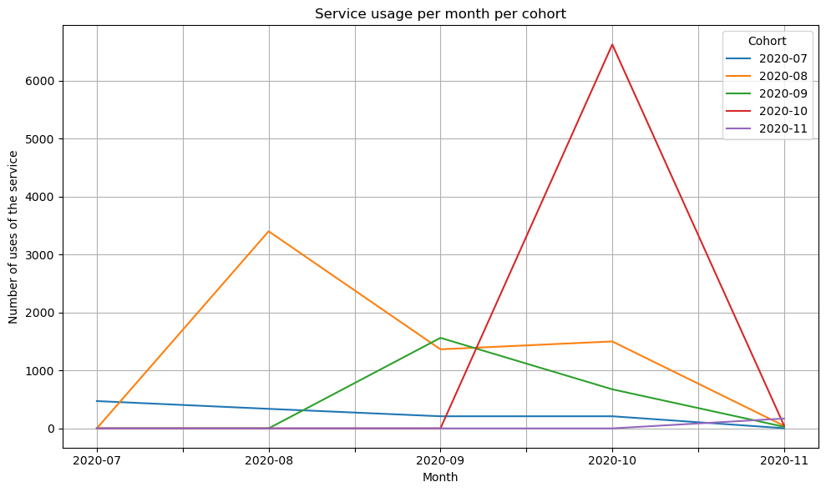
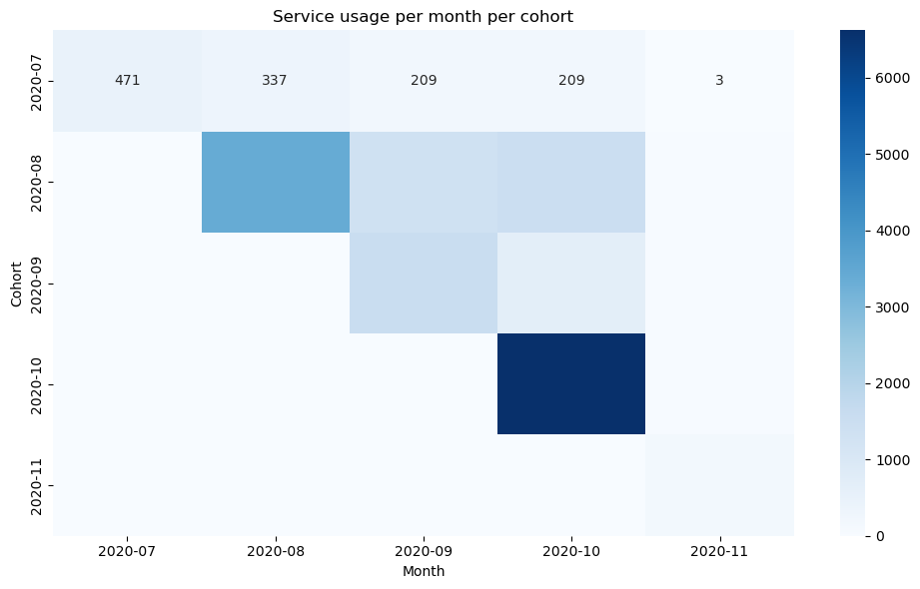
Different types of visualizations
Notes:
We also tried out two different types of charts for this first metric, however we found that the bar plots were the most intuitive.

Slide 8
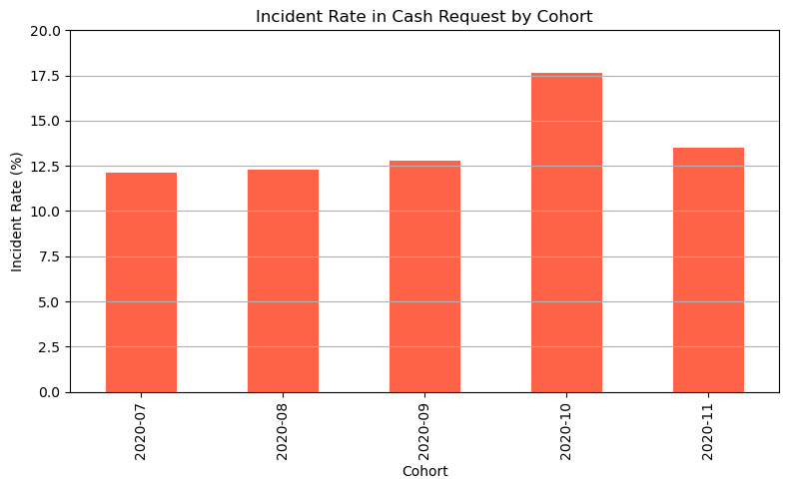
2nd metric: Incident rate
Insights:
Higher number of incident rates in October compared to other cohorts.
Interpretation:
The number of users in October were significantly higher than other cohorts, resulting in higher incident rates in CR.
Notes:
The second metric focuses on how often users in each cohort faced incidents.
We calculated the incident rate as a percentage of transactions that had reported issues.
As we can see here, the highest number is again in October, which may be caused by the fact that the usage in October was the highest.

Slide 9
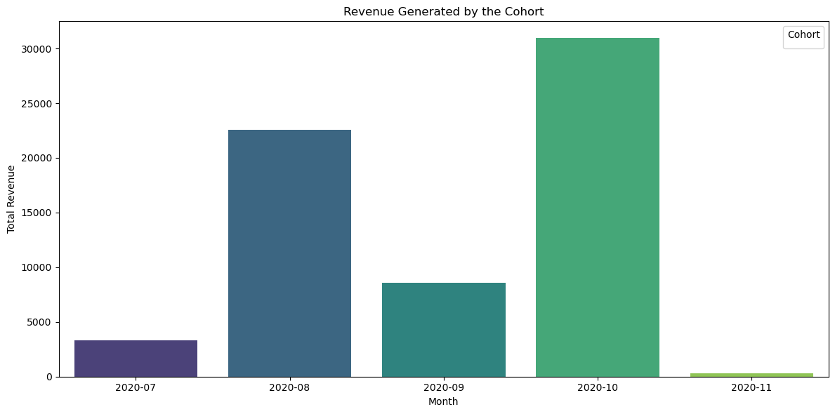
3rd metric: Revenue generated by the cohort
Insights
Revenue directly proportional to the no. of users in cohort.
Maximum revenue in October, least in November.
Notes:
We calculated this by using 3 columns, cohorts, total amount of fees and status.
we filtered only the rows with 'accepted' in status
and use groupby with cohorts and total amount, calculating the sum of the fees for each cohort
Again we can see a peak in October. Followed by a drop in November

Slide 10
Business Challenge
Cohort Analysis
Anriudh Unni, Raissa Franco & Ayse Kocyigit

